Slide 1

Thesis Presentation

Slide 2
Our Team Members
Imran Hosen
Hasibul Islam
Id: 2018-1-60-189
Id: 2018-1-60-122
Md Mahmud Hasan Tamim
Abdullah Al Nayeem
Id: 2018-1-60-107
Id: 2018-1-60-086
Supervised by
Tanni Mittra
Senior Lecturer
Department of Computer Science & Engineering

Slide 3
Thesis Topic
Aggressive Bangla Text Detection Using Machine Learning and Deep Learning Algorithms.

Slide 4


STEP
Introduction:
01
02
03
Bangla Text Classification
From Social Media
Aggressive Bangla text on
Social Media
Neutral Bangla text on Social Media

Slide 5
Objectives:
01
02
03
Detecting aggressive text as early as possible to deal with future problems.
Categorize bangla social media text into two Classes
To create a suitable data set for this research and apply different Algorithms.

Slide 6
Related Work:
Using machine learning al- gorithms and also comparing the performance of the module with other available techniques they achieved the best result using SVM at 95.40% on user post. And 97.27% using SVM on user specific data.
Md. Tofael Ahmed, Maqsudur Rahman, Shafayet Nur, & Azm Islam Dipankar Das
Abdhullah-Al-Mamun
&
Shahin khter
Developed a model to detect cyberbullying they used in total of 12 thousand dataset. Achieving the best result of 84%
Tanvirul Islam, Nadim Ahmed &
Subhenur
Latif
They Used supervised machine learning classifiers to detect Bangla abusive text. Using 12 thousand dataset with two class label and SVM give them best accuracy of 88%
Md. Abdul Awal, Md. Shamimur Rahman & Jakaria Rabbi
Using Naïve Bayes classifier to detect abusive comments on Youtube expressed in Bangla, they got 80.57% accuracy with 2.6 thousand data.

Slide 7




Data collection:
Data preparation:
Aggressive and neutral comments.
15 thousands data from different social media platform such as,
Cleaning: Data was cleaned
Without Character
Without Emoji
Extra Words
Labelling:
Over 8 thousands data for aggressive
7 thousands for neutral Data
Classified as ‘0’ for aggressive
Classified as ‘1’ for neutral

Slide 8

Data Splitting :
15 Thousands Data For Testing
8 Thousands Data For Aggressive
7 Thousands For Neutral
Train Set
Test set
70%
30%

Slide 9
Data processing:
Raw data
CSV form
Remove redundant variables
Numerical form
Checking outliers
Normalization

Slide 10
STEP
Methodology:
where can we get it? Is it public? Are there privacy concern
It is structured or unstructured
Data collection
What data exists?
Data preparation
Data analysis
Clean data
Labelled data
Train model
Choose algorithms
Overfit then regularize
Test model
Evaluate model
Evolution matrix
Feature importance
output

Slide 11
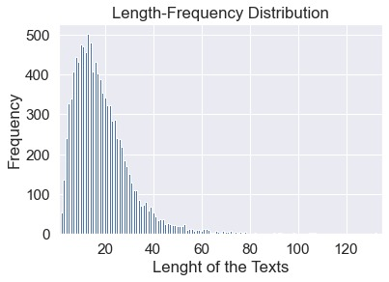
Data analysis:
.
Length-frequency distribution of the text count and the corresponding length of the texts. The highest text count was found at 13 length of the texts

Slide 12
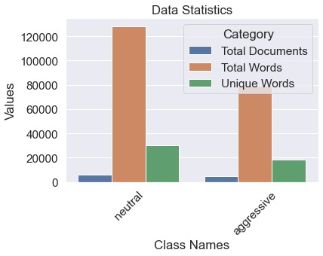
Data analysis:
This graph shows the total words and the unique words for neutral and aggressive individually.

Slide 13
STEP
Machine Learning Models:
Linear Regression
Support Vector Machine
Random Forrest
Linear Regression is a supervised machine learning algorithm which is used in regression problems. It predicting the continuous dependent variable with the help of independent variables from the data set. And to determine the best fit that precisely predict the accurate value for the continuous dependent variable.
Support Vector Machine or SVM is used to classify data points which helps finding a hyperplane in a K-dimensional space and K refers to number of features. Among many possible features the SVM chooses the feature with the maximum margin. Here in this research the authors used both Linear and Kernel SVM.
Random forest is a Supervised Machine Learning Algorithm that works very well with the Classification and Regression problems. Based on different samples and inputs, creates a sample weight for a problem and then takes the highest valued weight for classification problem and takes average weight for regression.

Slide 14
STEP
Machine Learning Models:
Decision Tree
Multinomial Naïve Bayes
K-Nearest Neighbors
A supervised learning method used for both classification and regression. Analyses the data features and predicts the value of the target variable by implementing decision rules.
The multinomial Naïve Bayes algorithm is based Bayes theorem and calculates the likelihood of occurrence of an event based on prior knowledge of the event's conditions using Bayes theorem. The highest probability is the output. Probability of P(A | x) where A is the of the possible outcomes given instance x. The equation is given below.
P(A|x) = P(x | A)* P(A) / P(x)
The k-nearest neighbors (KNN) algorithm is also a supervised learning algorithm that relies on labeled input data to learn a function. And later based on that learned function produces a feature appropriate output considering new unlabeled data.

Slide 15
STEP
Deep Learning Models (CNN –LSTM hybrid network):
Convolutional Layer: A convolutional layer is a set of n*n filters. The used parameters of the n*n filters are silds. Measured through the width and height of the input. It is measured by the dot products between the input and filter of the layer.
Dropout Layer: To improve the over-fitting problem on neural networks the regularization technique is used which is dropout layer. The formula of pulse on off technique is used in this particular layer during training. This makes the layer to adapt according to the same concept with different neurons.
Max-Pooling Layer: This layer is used to shrink down the spatial size of a convoluted feature. So, basically dimension reduction is done in this layer and padded to reduce the noise from actual meaningful data.
Flatten Layer: This layer is used to convert the data into 1-D array. It creates a flatten output of its previous layer. And a single long feature vector is created for the dense layer to perform classification through various models.
Dense Layer: This layer takes the values of all the previous layers and group them into a dense feature to perform classification.
CNN
A Convolutional Neural Network or CNN is a neural network designed particularly for processing structured arrays of image, video data. It is one of the most used Neural Network in computer vision. Here is the structure of CNN what we used.
Embedding Layer: In this layer all the words in the data set turned into vectors and used as the input of the embedding layer. This is the first layer of the neural network where a matrix is generated which represents the vectors and words.

Slide 16
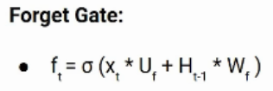


STEP
Deep Learning Models (CNN –LSTM hybrid network):
New information gets added or updated
LSTM
LSTM is a form of RNN designed to deal with the long term dependency due to fact that RNN has a vanishing gradient decent problem.
LSTM Architecture
Forgets the excessive information
Pass new added or updated information

Slide 17
Result Analysis[ML]:

Slide 18
Result Analysis[ML]:
89.45

Slide 19
Result Analysis[ML]:
90.46

Slide 20
Result Analysis[ML]:
90.46
ACCURACY OF ALL ALGORITHM

Slide 21
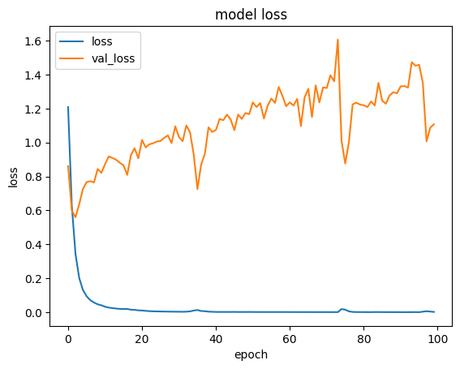
Result Analysis
[CNN-LSTM Hybrid Network ]:
This model Loss curve shows us how a model behaves after each iteration of optimization.

Slide 22
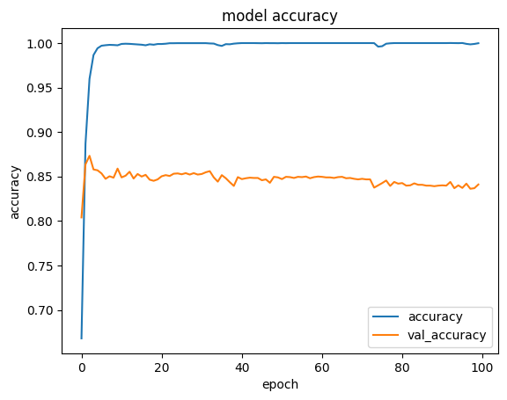
Result Analysis
[CNN-LSTM Hybrid Network ]:
An model accuracy curve shows the measurement of the algorithm’s performance. The accuracy of a model is usually determined after the parameters are calculated

Slide 23
Result Analysis with CNN-LSTM Hybrid Network:
Train Accuracy | Test Accuracy
0.9978 | 0.8472
Train Accuracy | Test Accuracy
0.9995 | 0.8515
Train Accuracy | Test Accuracy
0.9975 | 0.8512

Slide 24
Result's Comparison ML vs CNN:

Slide 25
Future Works:
01
02
03
Other Deep Learning algorithms can be used like GRU, Attention based models, RNN
More data can be used for training and testing purposes.
The more user specific posts and comment can help improve the result.

Slide 26
Conclusion:
Apply Deep Learning Algorithm
CNN-LSTM HYBRID NETWORK
Best Result
Multinomial Naïve Bayes with 90.46% accuracy
NLP classification problems
Classification Algorithms work better

Slide 27
Reference:
[1] Editors of Encyclopedia Britannica. (Aug, 2022) Bengali Language. [online]. Available: https://www.britannica.com/topic/Bengali-language.
[2] Abdhullah-Al Mamun, Shahin Akhter, “Social media bullying detection using machine learning on Bangla text,” 10th International Conference on Electrical and Computer Engineering (ICECE), 2018, pp. 385-388.
[3] Md. Tofael Ahmed, Maqsudur Rahman, Shafayet Nur, Azm Ariful Islam, Dipankar Das, “Deployment of Machine Learning and Deep Learning Algorithms in Detecting Cyberbullying in Bangla and Romanized Bangla text: A Comparative Study,” International Conference on Advances in Electrical, Computing, Communication and Sustainable Technologies (ICAECT), 2021, pp. 1-10.
[4] Estiak Ahmed Emon, Shihab Rahman, Joti Banarjee, Amit Kumar Das, Tanni Mittra, “A Deep Learning Approach to Detect Abusive Bengali Text,” 7th International Conference on Smart Computing & Communications (ICSCC), 2019, pp. 1-5.
[5] Tanvirul Islam, Nadim Ahmed, Subhenur Latif, “An evolutionary approach to comparative analysis of detecting Bangla abusive text,” Bulletin of Electrical Engineering and Informatics, 2021, vol-4, pp. 2163-2169.

Slide 28
[6] Rashedul Amin Tuhin, Bechitra Kumar Paul, Faria Nawrine, Mahbuba Akter, Amit Kumar Das, “An Automated System of Sentiment Analysis from Bangla Text using Supervised Learning Techniques,” 2019 IEEE 4th International Conference on Computer and Communication Systems (ICCCS), 2019, pp. 360-364.
[7] Md. Abdul Awal and Md Shamimur Rahman and Jakaria Rabbi, “Detecting Abusive Comments in Discussion Threads Using Naive Bayes,” 2018 International Conference on Innovations in Science, Engineering and Technology (ICISET), 2018, pp. 163-167.
[8] Maliha Jahan, Istiak Ahamed, Md. Rayanuzzaman Bishwas, Swakkhar Shatabda, “Abusive Comments Detection in Bangla-English Code-mixed and Transliterated Text,” 2019 2nd International Conference on Innovation in Engineering and Technology (ICIET)}, 2019, pp. 1-6
[9] The DataReportal.[online] available: https://datareportal.com/essential-facebook-stats
[10] Editorial. [online] Available: https://www.oberlo.com/statistics/what-age-group-uses-social-media-the-most
[11] Dave Chaffey, [22 Aug,2022], [Online] Available: https://www.smartinsights.com/social-media-marketing/social-media-strategy/new-global-social-media-research/
[12] SIMON KEMP, [15 Feb, 2022]. [Online] Available: https://datareportal.com/reports/digital-2022-bangladesh
[13] Nixon C. L. (2014). Current perspectives: the impact of cyberbullying on adolescent health. Adolescent health, medicine and therapeutics, pp. 143–158.

Slide 29


Slide 30
Any Question..?

